Slide 1

Sales Insights Dashboard for Insurance Company
Real-time Sales, Customer,
and Revenue Insights
- Prem Shende

Slide 2
Agenda
Project Overview
Technologies & Tools
Problem Statements & Objectives
Data Flow & Architecture
Key Insights Explored
Workflow & Approach
Demo Preview (optional)

Slide 3
Project Overview
Goal: Provide real-time insights for decision-making in sales, customer behavior, and profitability.
Key Business Questions:
Which products perform best?
Customer segmentation insights
Sales trends and forecasting
Regional sales analysis
Profit and revenue optimization

Slide 4

Technologies & Tools
Snowflake: Raw data storage
DBT: Data transformation
Apache Airflow: Orchestration and automation
Tableau: Visualization and dashboard creation
GitHub: Version control and project repository

Slide 5

Problem Statements & Objectives
Problem Statements:
How can we identify top-performing insurance products?
What customer segments are more likely to purchase certain products?
How can we predict future sales trends?
What regions are performing best?
How can we optimize profit and revenue?
Objective:
Automate sales insights, reduce manual effort, and enable data-driven decision-making.

Slide 6
Data Work Flow & Architecture
Data Sources: Generated using Python's Faker library
Data Storage: Ingested into Snowflake
ETL Process: DBT handles data transformation
Automation: Apache Airflow schedules and manages tasks
Visualization: Tableau connects to Snowflake for interactive dashboards

Slide 7
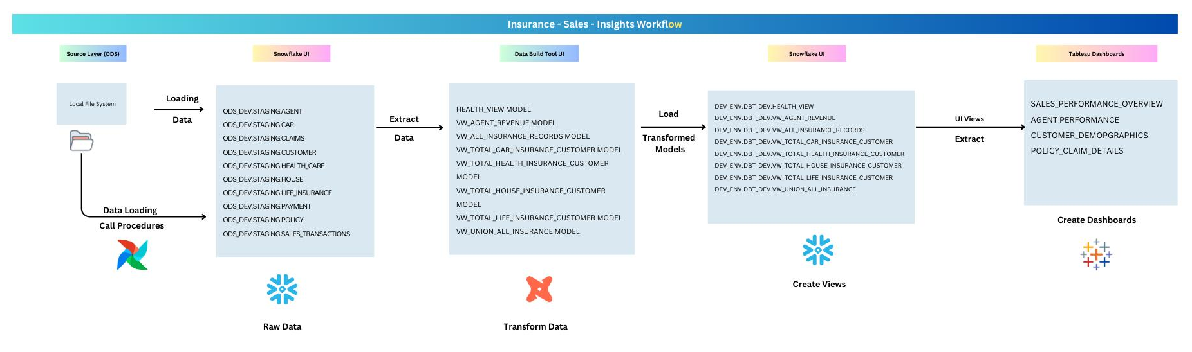
Work Flow

Slide 8

Key Insights Explored
Top-performing products
Customer segments likely to purchase
Sales forecasts
Geographical sales performance
Revenue and profit margins

Slide 9
Workflow & Approach
Step 1: Generate fake data using Python (Faker library)
Step 2: Ingest data into Snowflake for storage
Step 3: Set up a free trial of DBT and connect it to Snowflake
Step 4: Install Apache Airflow locally for DAG automation
Step 5: Download Tableau (Public or Desktop) and connect to Snowflake
Step 6: Build and save dashboards in Tableau for data insights

Slide 10
Detailed Workflow
Data Ingestion: From local files to Snowflake
Data Transformation: Using DBT to transform raw data
Automation: DAG scheduling and orchestration with Apache Airflow
Visualization: Tableau dashboards for real-time data insights

Slide 11
Demo Preview
CLICK HERE

Slide 12

THANK YOU!

